Slide 1








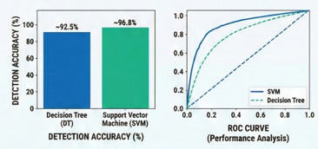


BACKGROUND AND PROBLEM STATEMENT
APPLYING MACHINE LEARNING FOR MALWARE DETECTION
IN HOSPITAL IT SYSTEMS
Quan, Vo Anh ^{1,2}
¹ University of Information Technology – VNU-HCM
² Vietnam National University, Ho Chi Minh City
Methodology Overview
Hospital IT systems face serious cybersecurity threats such as ransomware and malware.
Traditional signature-based detection methods are insufficient against evolving attacks.
Ensuring patient data privacy and system availability is critical.
RESEARCH OBJECTIVES
Hospital IT systems face serious cybersecurity threats such as ransomware and malware.
Traditional signature-based detection methods are insufficient against evolving attacks.
Ensuring patient data privacy and system availability is critical.
METHODOLOGY OVERVIEW
MACHINE LEARNING MODELS
DECISION TREE:
Interpretable model with hierarchical feature splits.
SUPPORT VECTOR MACHINE (SVM):
Effective for high-dimensional feature spaces.
EXPERIMENTAL SETUP AND EVALUATION
Dataset includes benign software and real-world malware samples.
Evaluation metrics: Accuracy, Precision, Recall, F1-score, False Positive Rate.
Cross-validation used to ensure robustness.
RESULTS COMPARISON
SVM achieved higher detection accuracy than Decision Tree.
Lower false positive rate observed with SVM.
ROC analysis confirms stronger generalization performance.
PRACTICAL APPLICATION IN HOSPITAL ENVIRONMENTS
Deployable at hospital network gateways or as a standalone security tool.
Supports real-time file analysis and automated alerts.
Helps mitigate threats before compromising HIS/EHR systems.
CONCLUSION AND FUTURE WORK
Machine learning, especially SVM, is effective for hospital malware detection.
Approach enhances overall cybersecurity posture.
Future work: deep learning, dynamic analysis, centralized security dashboards.

